Slide 1
Using multivariate autoregressive models to estimate interaction strengths, aka the B matrix Part II: community dynamics
Eli Holmes
FISH 507 – Applied Time Series Analysis
28 February 2017

Slide 2
Topics
MAR(1) models as sum of community interactions
MAR(1) models as a general approximation to nonlinear systems
Stability properties of MAR(1) models
Estimating MAR(1) models
The theory in this lecture draws largely from
Ives AR, Dennis B, Cottingham KL, Carpenter SR. 2003. Estimating community stability and ecological interactions from time series data. Ecological Monographs 73: 301-330
Many ecological applications are reviewed in
Hampton, S.E., E.E. Holmes, D.E. Pendleton, L.P. Scheef, M.D. Scheuerell, and E.J. Ward. 2013. Quantifying effects of abiotic and biotic drivers on community dynamics with multivariate autoregressive (MAR) models. Ecology 94:2663-2669
Links to both are on the course syllabus

Slide 3

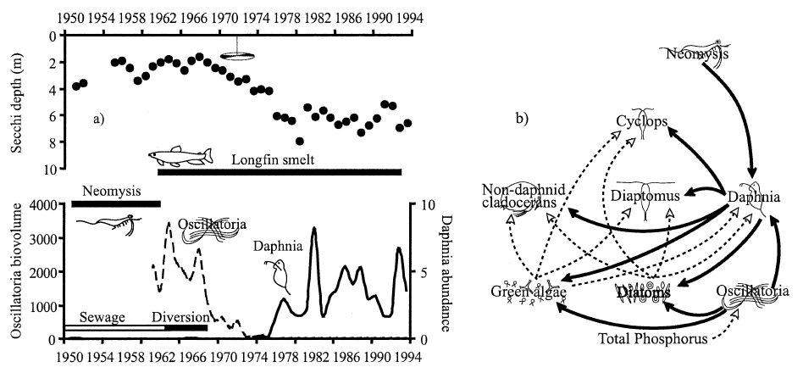
Lake Washington: a large change insewage inputs in the late 1960s led to a dramatic change in the plankton community
Hampton et al. (2006)
Notes:
MAR(1) Workshop - ESA 2007, San Jose, CA
5 Aug 2007

Slide 4
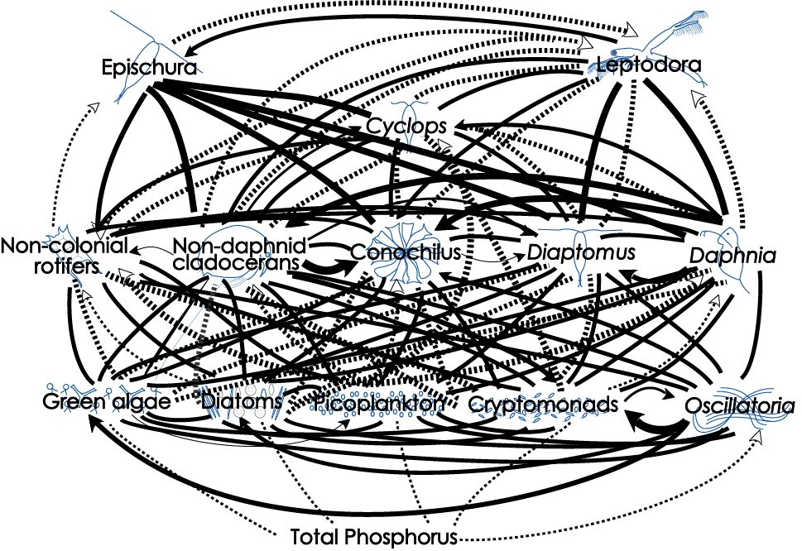
How can we make sense of this?
Dashed lines are (+) interactions; solid lines are (-)
Hampton et al. (2006)
Notes:
MAR(1) Workshop - ESA 2007, San Jose, CA
5 Aug 2007

Slide 5
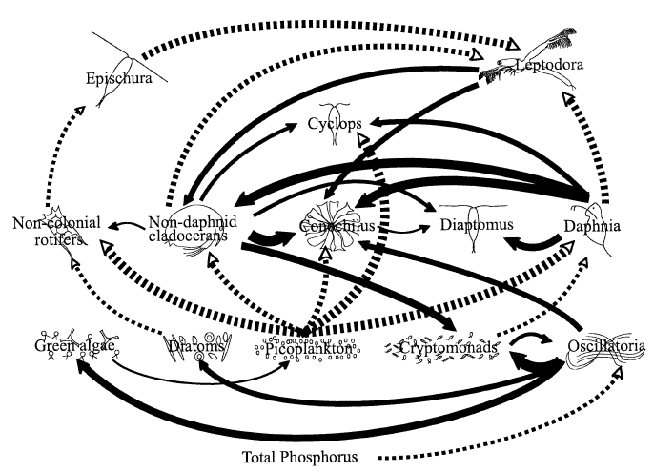
And reduce to the ‘important’ links?
Dashed lines are (+) interactions; solid lines are (-)
Hampton et al. (2006)
Notes:
MAR(1) Workshop - ESA 2007, San Jose, CA
5 Aug 2007

Slide 6
Multivariate AR(1) process, “MAR1”
Note no SS part
Assume p different interacting species, then for each sp. i:
B
X_{j,t-1} is abundance of species j at time t-1
b_{ij} is effect of species j on species i
Note: when i = j, b_{ij} is effect of species i on itself

Slide 7
Multivariate AR(1) process
Can add effects of q different environmental covariates (U):
q=2
c_{k,t} is covariate k (e.g., temperature) at time t
C_{ik} is effect of covariate k on species i
NOTE: covariate not time lagged; if you want a time-lagged covariate you need to use the time-lagged covariate as c_{t}

Slide 8
Multivariate AR(1) process
Can write all of this as:
x_{t} is p x 1 vector of species abundance at time t
u is p x 1 vector of intrinsic growth rates
B is p x p matrix of density-dependent effects
x_{t-1} is p x 1 vector of species abundance at time t-1
C is p x q matrix of covariate effects
c_{t} is q x 1 vector of covariate values at time t

Slide 9
Multivariate AR(1) process
A note on the B matrix structure:
Inter-specific effects
(can be set to zero)
Inter-specific effects
(can be set to zero)
Intra-specific effects

Slide 10
Real systems do not necessarily have log-linear density-dependence
Note: If N is not spanning very large values a linear model may suffice
Nonlinear
Linear approx.
log N_{t+1}
log N_{t+1}
log N_{t}
log N_{t}
Modern literature on MAR(1) models allow B to be time-varying which allows that linear approximation to vary in time.

Slide 11
Stationary distribution for MAR(1)
Mean vector:
Covariance matrix:
Note: cannot solve analytically this for V∞
Solution: use the Vec(•) operator
(analogous to the univariate case)

Slide 12
Stability properties of MAR(1) models
Our interest is in stable systems
(i.e. all eigenvalues of B lie within unit circle)
Stability can be measured in several ways, but here are three that we will use:
Stability measure | More stable when…
Variance | variance of the stationary distribution is low relative to that for the process error
Return rate | rapid approach to the stationary distribution (i.e. high return rate)
Reactivity | fewer departures from the mean of the stationary distribution (i.e. low reactivity)

Slide 13
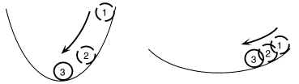
Stability properties of MAR(1) models
Return rates (ie, resilience)
In deterministic models, equilibrium is a point or stable limit cycle
In stochastic models, equilibrium is the stationary distribution
Rate of return to the stochastic equilibrium is the rate at which the transition distribution converges to the stationary distribution from an initial, known value
The more rapid the convergence, the more stable the system
More stable
Less stable
Fig. 2B - Ives et al. (2003)

Slide 14
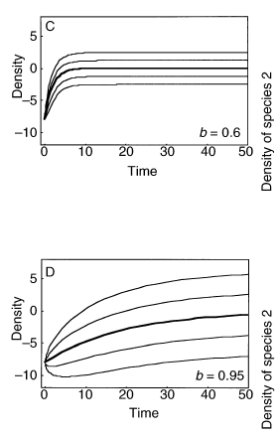
Stability properties of MAR(1) models
Return rates
Rate of return increases as |b| gets smaller
Rate of return to mean governed by dominant eigenvalue of B ≡ max(λ_{B})
Rate of return of covariance defined by dominant eigenvalue of B⊗B ≡ max(λ_{B⊗B})
Take home msg: you can write the return rate as a function of B. So if we can estimate B, we can say something about the stability of the system as measure by return rate.
Fig. 3 - Ives et al. (2003)

Slide 15
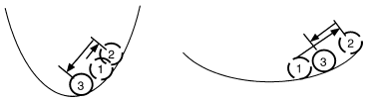
Stability properties of MAR(1) models
Reactivity
A “reactive” system moves away from a stable equilibrium following a perturbation, even though the system will eventually return to equilibrium.
Low reactivity
High reactivity
Fig. 2C - Ives et al. (2003)
High reactivity occurs when species interactions greatly amplify the environmental forcing
Not how fast does it return but how far does it go?

Slide 16
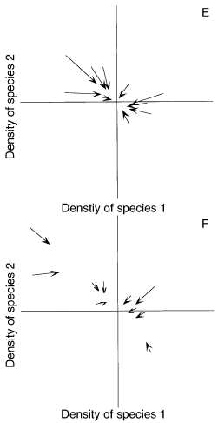
Stability properties of MAR(1) models
Reactivity
Squared Euclidian distance for X_{t-1} from μ∞
Squared Euclidian distance for X_{t} from μ∞
Change in squared Euclidian distance
Expectation of this difference
Fig. 3 - Ives et al. (2003)
“worst-case” scenario
Another form of reactivity is given in Neubert et al. (2009)

Slide 17
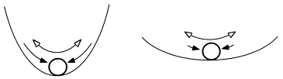
Stability properties of MAR(1) models
Variance comparison
Generally interested in the time spent away from equilibrium
More time → greater variance
More stable
Less stable
Fig. 2A - Ives et al. (2003)
Combines properties of both return rate and reactivity

Slide 18
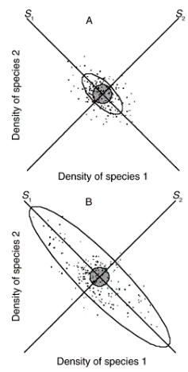
Stability properties of MAR(1) models
Variance comparison
1)
Smaller λ → smaller υ → more stable
2)
To standardize across various systems
Smaller λ → smaller det(B)^{2/p} → more stable
Fig. 3 - Ives et al. (2003)

Slide 19
MAR(1) parameter estimation
Maximum likelihood estimation (MLE)
Goal: find the B and C, that maximize the likelihood conditioned on the observed data.
Pro: does not require the assumption of no observation error (we can add an observation process) and allows missing values.
Con: Slow.

Slide 20
MAR(1) parameter estimation
dat=“some m x T matrix of log species abundances”
mod.list = list(
B=“unconstrained”,
U=“zero”,
Q=“diagonal and unequal”,
Z=“identity”,
A=“zero”,
R=“zero”,
C=“unconstrained”, c=“some q x T matrix of covariates”,
x0=dat[,1,drop=FALSE], tinitx=1
)
MARSS(dat, model=mod.list)
maximum-likelihood estimation via Expectation-Maximization algorithm or method=“BFGS” to use optim() and a quasi-Newton method.
Notes:
MAR(1) Workshop - ESA 2007, San Jose, CA
5 Aug 2007

Slide 21
Goal is to find a simpler system to explain the observed species changes
13 x 13 B matrix
Compare model support of models with different B’s set to zero
156 non-diagonal B terms. There are approximately 1e+47 (that’s 1 followed by 47 zeros) unique B matrices with different 0s.
We cannot do a brute force fitting of all models.
We should try to set some of those Bs to 0 via prior knowledge about the system
We need a fast estimation algorithm
Notes:
MAR(1) Workshop - ESA 2007, San Jose, CA
5 Aug 2007

Slide 22
Much faster MAR(1) parameter estimation
Conditional least squares (CLS)
The CLS parameter estimates are those values that minimize the squared difference between
the observed log population abundances at time t, and
those predicted by the MAR(1) model, conditional on the log population abundances at time t-1.
Requires the assumption of no observation error and no missing values allowed.

Slide 23
Conditional least squares (CLS)
m x (T-1)
(m x 1)(1 x T-1)
m x q
m x (T-1)
q x (T-1)
m x m
We work row by row through the equation and solve for each row of u, B and C.
1 x (T-1)
(T-1) x 1
1 x (T-1)
Row i: find
where
^
Let
and
^
then
Note Ives et al. 2003 writes this transposed.

Slide 24
MAR(1) parameter estimation
Conditional least squares (CLS)
There are a couple of advantages to solving this via CLS:
It’s VERY fast, and
It’s easy to zero out elements of B to “test” for their significance

Slide 25
MAR(1) parameter estimation
Conditional least squares (CLS)
There are a couple of advantages to solving this via CLS:
It’s VERY fast, and
It’s easy to zero out elements of B to “test” for their significance

Slide 26
MAR(1) parameter estimation
General steps to a MAR(1) analysis
Look at the data. Hopefully it looks like a mean-reverting process.
Deal with issues like seasonality and trends (look at papers to study how other have done this....)
Demean and standardize the variance of log population size and covariates
Impose biological constraints. “zooplankton are not affected by nitrogen”, “fish do not eat green algae”
Model selection for the B matrix

Slide 27
Search strategy for large model spaces
Best of 100 random search
100 models are generated by randomly including (50/50) each b element.
Best model (lowest AIC or BIC) is saved
Repeat 100 times to get a set of 100 “best” model.
Remove any variables that appears in less than 15 of the 100 best models.
Repeat the ‘Best of 100’ search (steps 1-3) with the new smaller set of variables.
Repeat steps 1-5 until number of variables in the 100 best is stable and chose best model.

Slide 28
Search strategy for large model spaces
Exhaustive via “leap and bound” algorithm
Algorithms to find best model over all possible variable combinations without actually doing exhaustive search.
Forward step-wise
Start with no off-diagonal b.
Add the b that most improves (reduces) model AIC
Stop at some step-AIC threshold
Backward step-wise
Same as forward but start with full model (all b’s)

Slide 29
Model diagnostics
Once selected, a MAR(1) model should be scrutinized
Useful diagnostics include:
Are residuals temporally autocorrelated (via ACF)?
Are mean or variance of the residuals correlated with any variates or covariates (via X-Y plots)?
Are residuals normally distributed (via normal probability plots)?
What proportion of the variance is explained by the model (via conditional R²)?
Note: conditional R² measures the proportion of change in log density from time t-1 to t

Slide 30
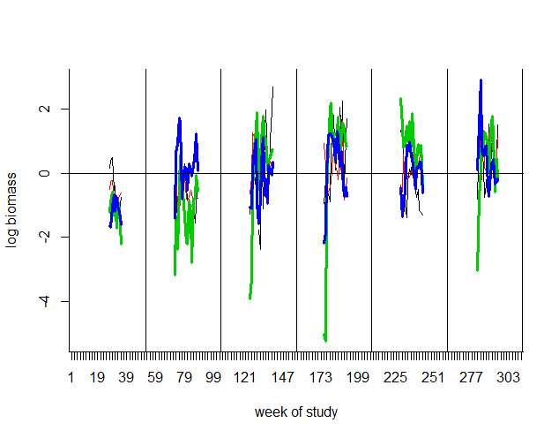
Model diagnostics
Example of demeaned plankton data, 4 spp (Ives et al 2003)
we are fitting one B matrix (and u)
so level changes need to be explained by the covariates

Slide 31
Parameter confidence intervals (CI)
Can obtain CI’s from model in 3 ways:
“Innovations” bootstrapping (how Ives et al (2003) does it)
Parameter estimation produces state residuals (w_{t})
Randomly resample the residuals (by column) to produce a new X (meaning use as your w_{t})
Use new X to again estimate parameters
Repeat “many” times
Estimate CI’s from distribution of parameter estimates

Slide 32
Parameter confidence intervals (CI)
Parametric bootstrapping if you use a MLE method
Generate parametric bootstrap data from the MLE model
Use new data to again estimate parameters (bootstrap parameter estimates)
Repeat “many” times

Slide 33
Parameter confidence intervals (CI)
3) Estimate CI’s from the (estimated) distribution of parameter estimates
Estimate the Hessian matrix (there are various R functions to do this)
Use that to compute the (estimated) CIs
Large-n approximation

Slide 34
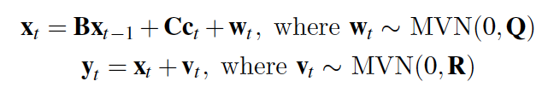
MAR(1) with observation error
This is simply our (now) familiar MARSS model:

Slide 35
See the MARSS User Guide for a computer lab that walks through
Fit community interaction model to freshwater plankton data from Ives et al. (2003)
Add covariates to the above model
Add an additional covariate (fish) observed with error
Compute stability metrics
MAR1 package on CRAN will apply the Ives et al 2003 algorithms to data sets.

